Slide 1
WORLD POPULATION ANALYSIS
By- Kumari Neha

Slide 2

Introduction
Overview of the project: This project involves analyzing global population data and building a predictive model to forecast future population trends. The project utilizes machine learning techniques to model the relationship between population growth and factors like birth rate, death rate, and migration.
Importance of population analysis: Understanding population growth is crucial for planning resources, infrastructure, and policies. Population trends influence everything from economic development to climate change.

Slide 3
Data Collection
Source of data: The dataset is loaded from a CSV file titled world_population.csv, which presumably contains historical data on global population metrics.
Description of dataset features: Key features in the dataset include:
Year: The year of observation.
BirthRate: Number of births per 1,000 people.
DeathRate: Number of deaths per 1,000 people.
NetMigration: Net migration rate.
FertilityRate: Average number of children per woman.
Population: Total population count for the corresponding year.

Slide 4
Data Preprocessing
Handling missing values: Missing values in the dataset are handled by removing rows with null values using the dropna() method.
Feature selection and engineering:
Features like BirthRate, DeathRate, NetMigration, and FertilityRate are selected for the model.
An additional feature, GrowthRate, is created to represent the year-on-year percentage change in population.

Slide 5
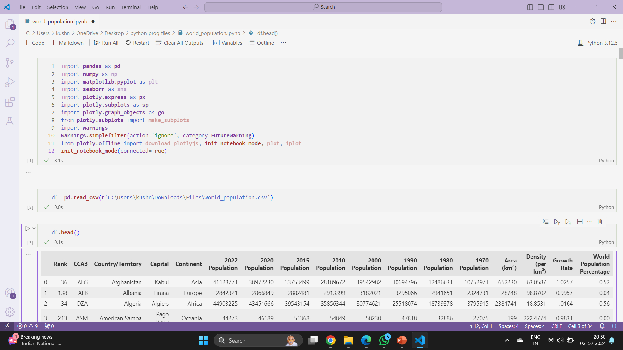
Import Packages

Slide 6
Exploratory Data Analysis (EDA)
Summary statistics: The basic structure of the dataset, such as data types and null values, is reviewed using data.info().
Visualization of population trends: A line plot is used to visualize actual population data over time
Analysis of key factors affecting population growth: Factors like birth rate, death rate, and migration are likely analyzed to understand their relationship with population growth.

Slide 7
Model Building
Description of the machine learning model used: A linear regression model is used to predict population growth based on the selected features.
Training and testing dataset split: The dataset is split into training and testing sets using a 70-30 ratio with the train_test_split() function.
Feature scaling: The features are scaled using StandardScaler to normalize the data for better performance of the linear regression model.

Slide 8
Model Evaluation
Performance metrics:
Mean Squared Error (MSE) is calculated to measure the average squared difference between actual and predicted population values.
R² score is used to determine how well the model fits the data.
Comparison of predicted vs actual population: The predicted population is compared to the actual population using a line plot, which shows both trends over time.

Slide 9

Data Cleaning

Slide 10


Slide 11
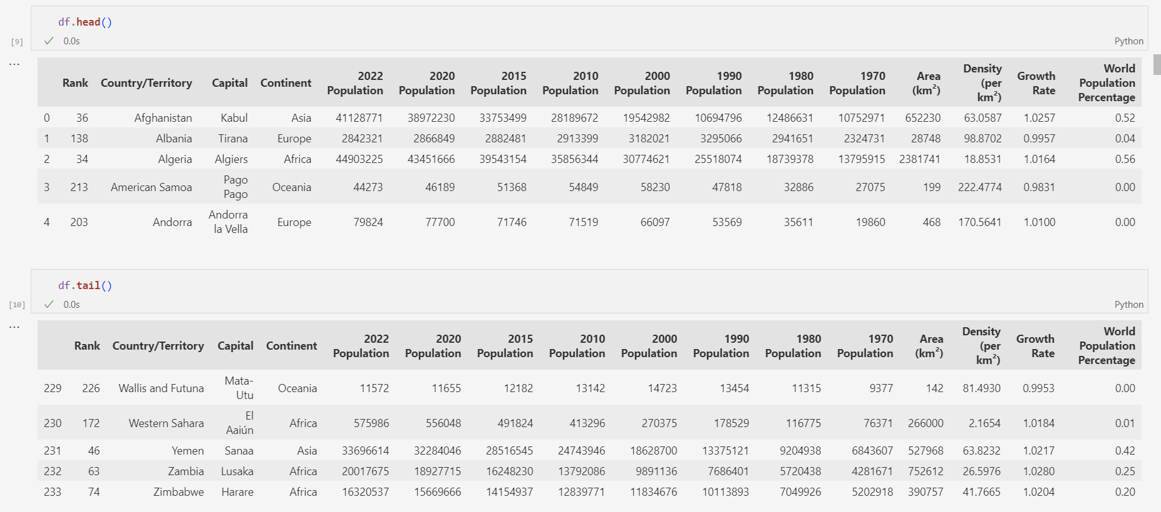
World Population Dataset

Slide 12
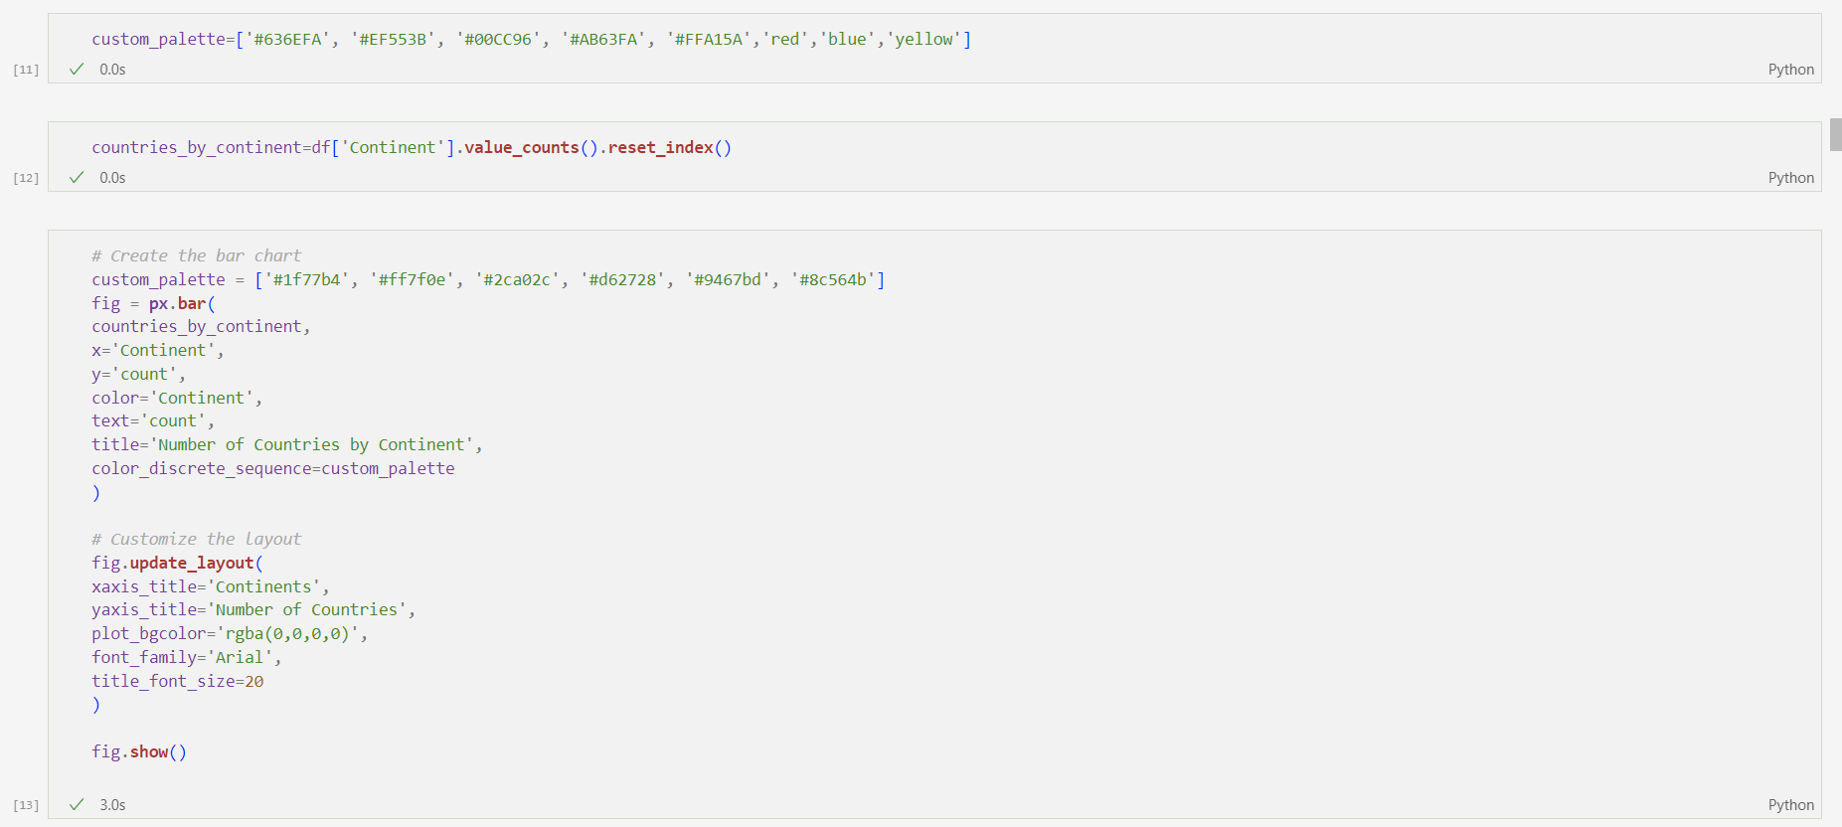
Visualization
Number of Countries by Continent

Slide 13
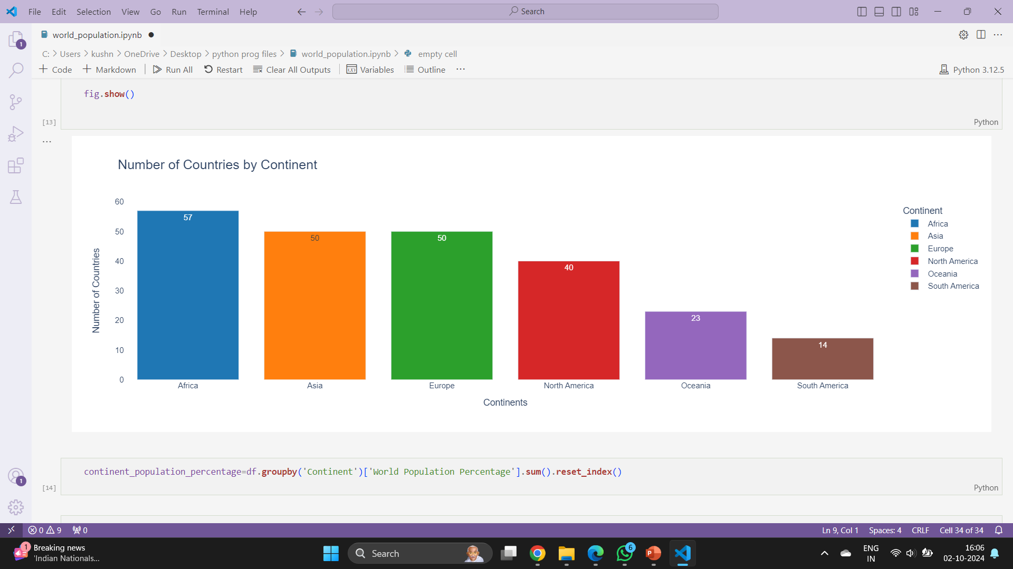

Slide 14
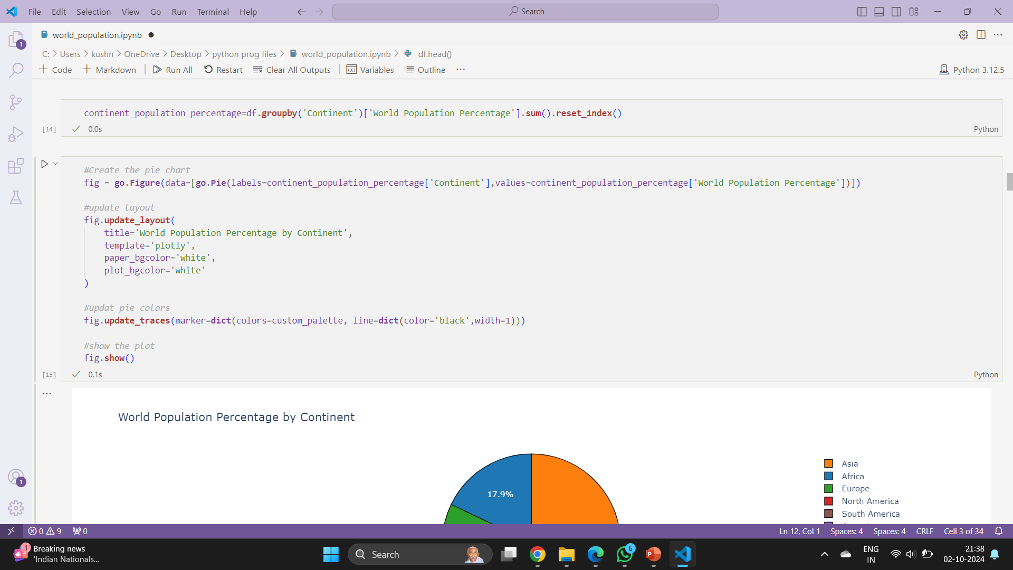
World Population Percentage by Continent

Slide 15
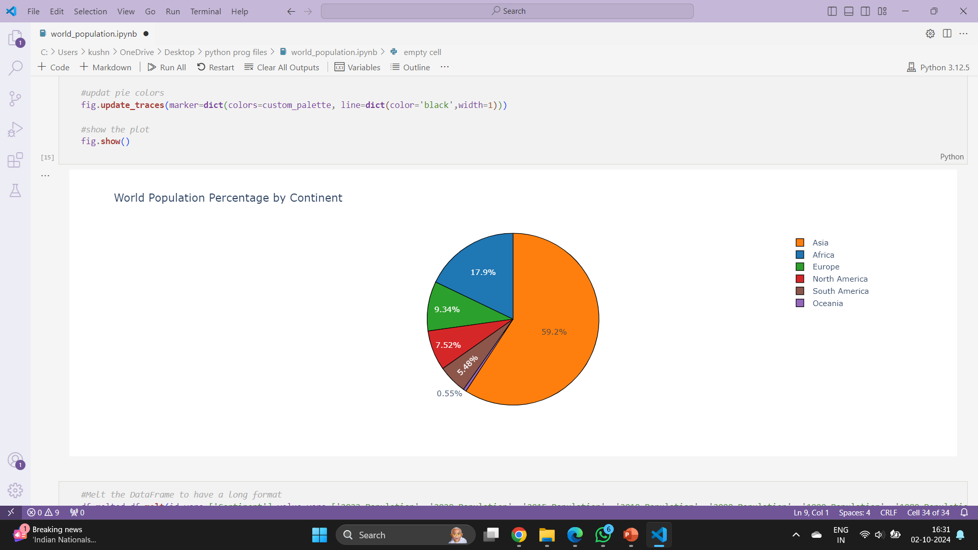

Slide 16
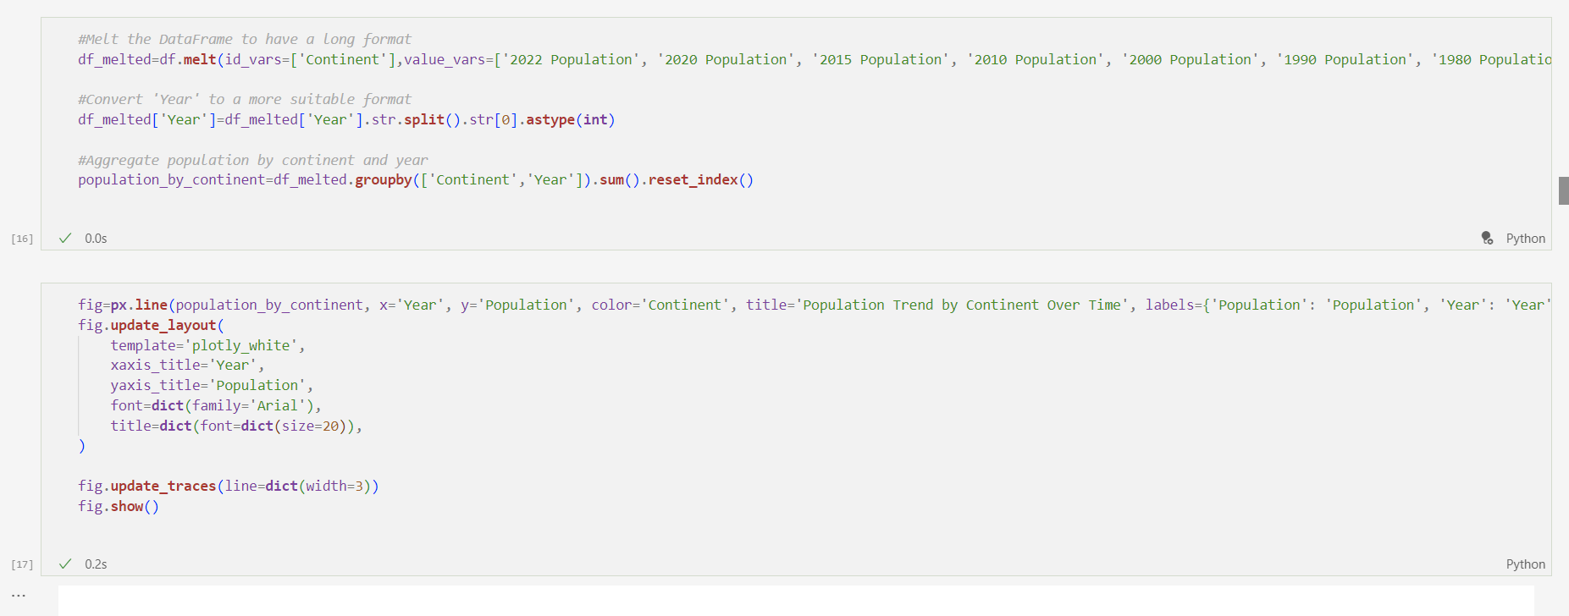
Population Trend by Continent Over Time

Slide 17
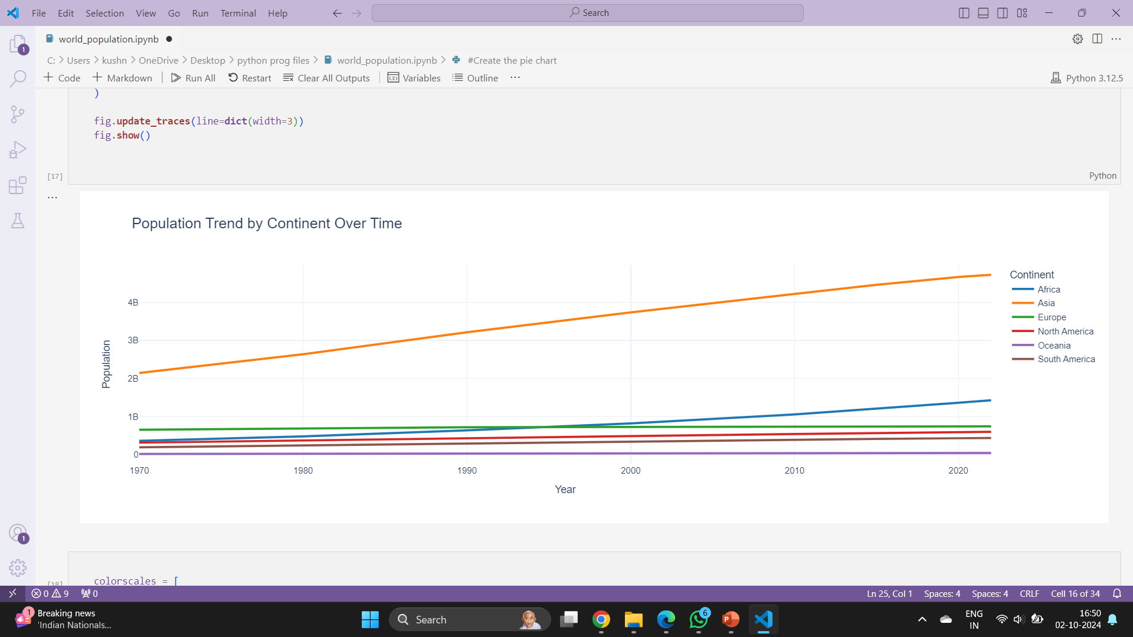

Slide 18
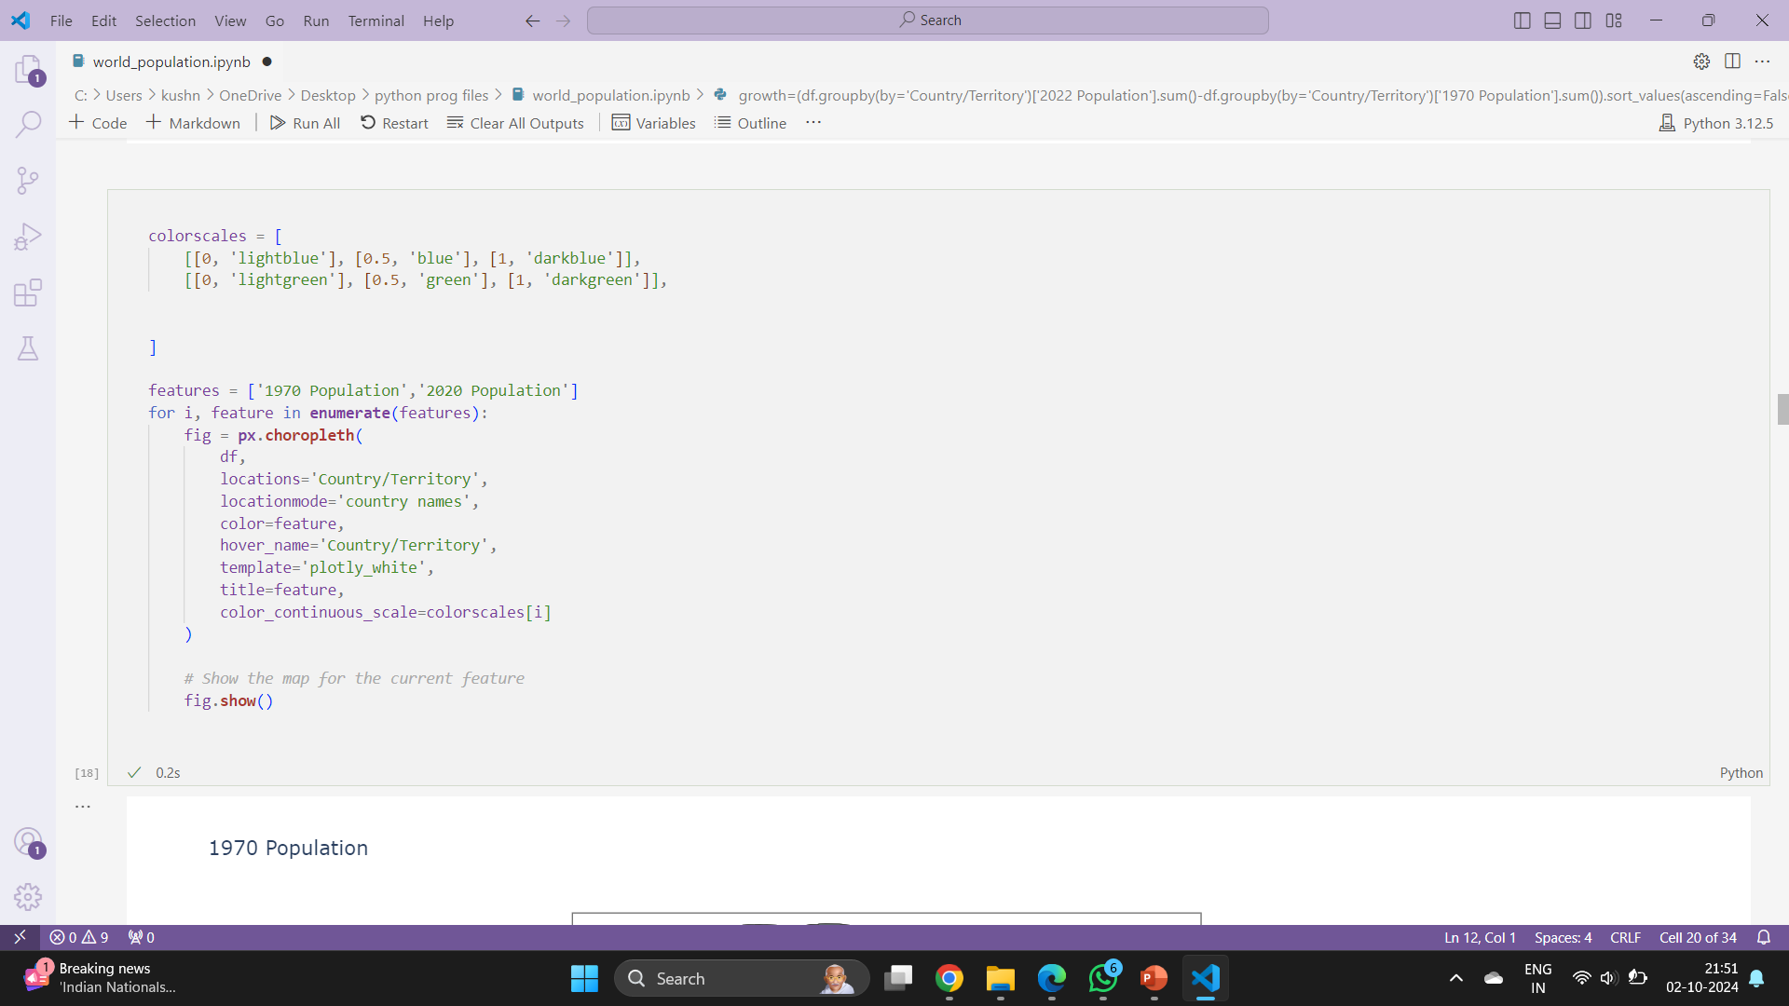
World Population Comparison: 1970 to 2020

Slide 19
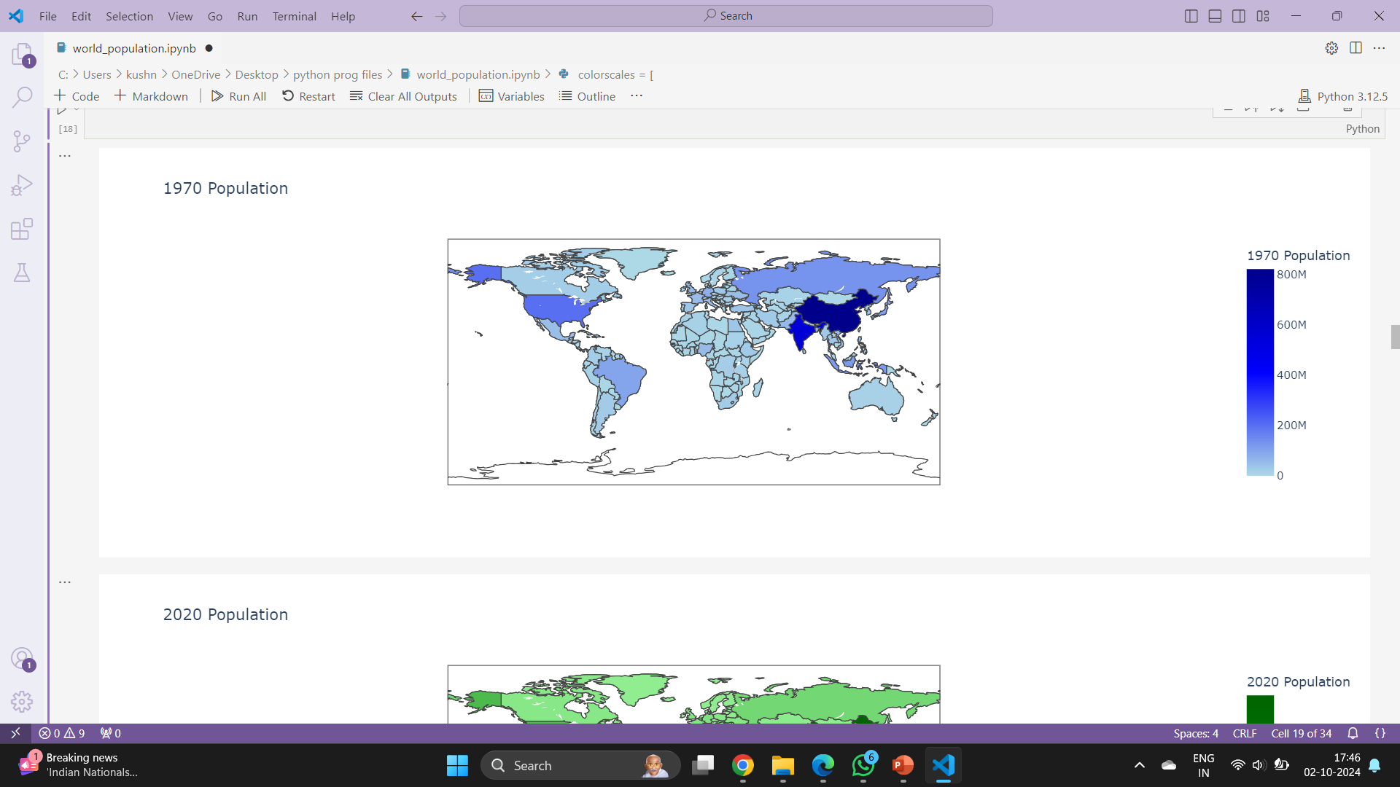

Slide 20
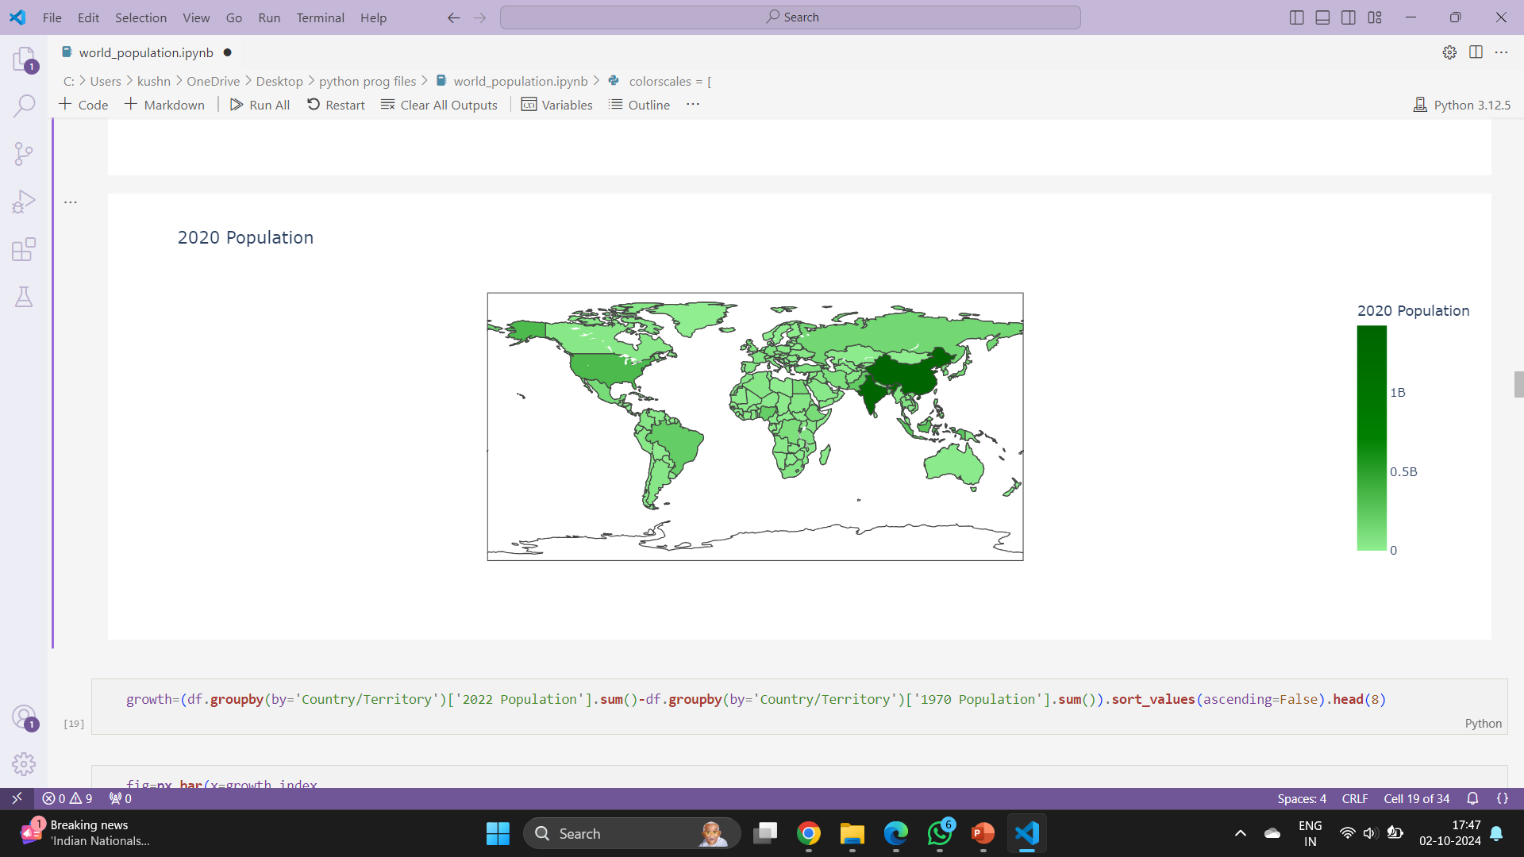
Over the past 50 years, India has experienced a remarkable population growth. In 1970, the population of India was approximately 557 million. By 2020, this number had surged to around 1.4 billion, reflecting the significant demographic changes the country has undergone in just over half a century.

Slide 21
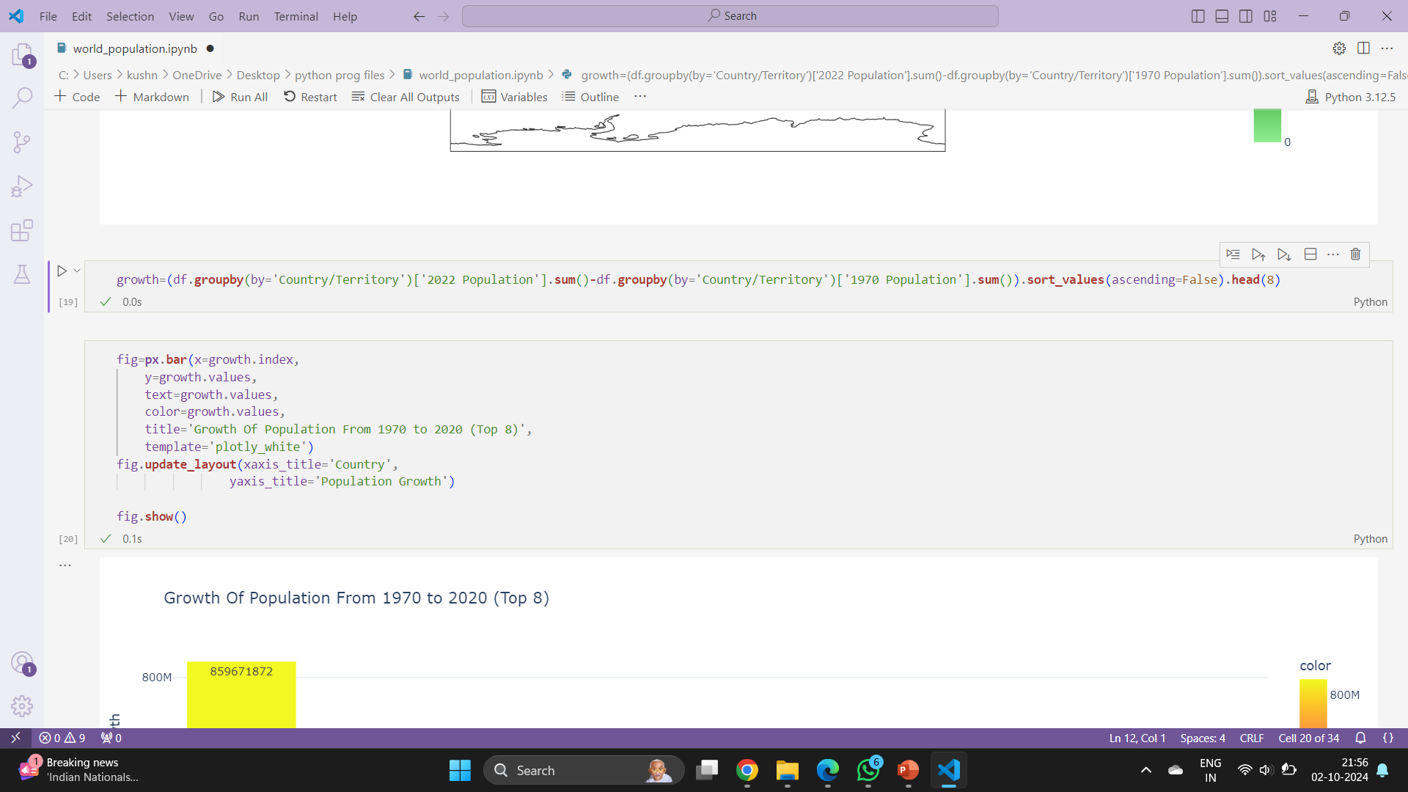
Growth Of Population From 1970 to 2020 (Top 8)

Slide 22
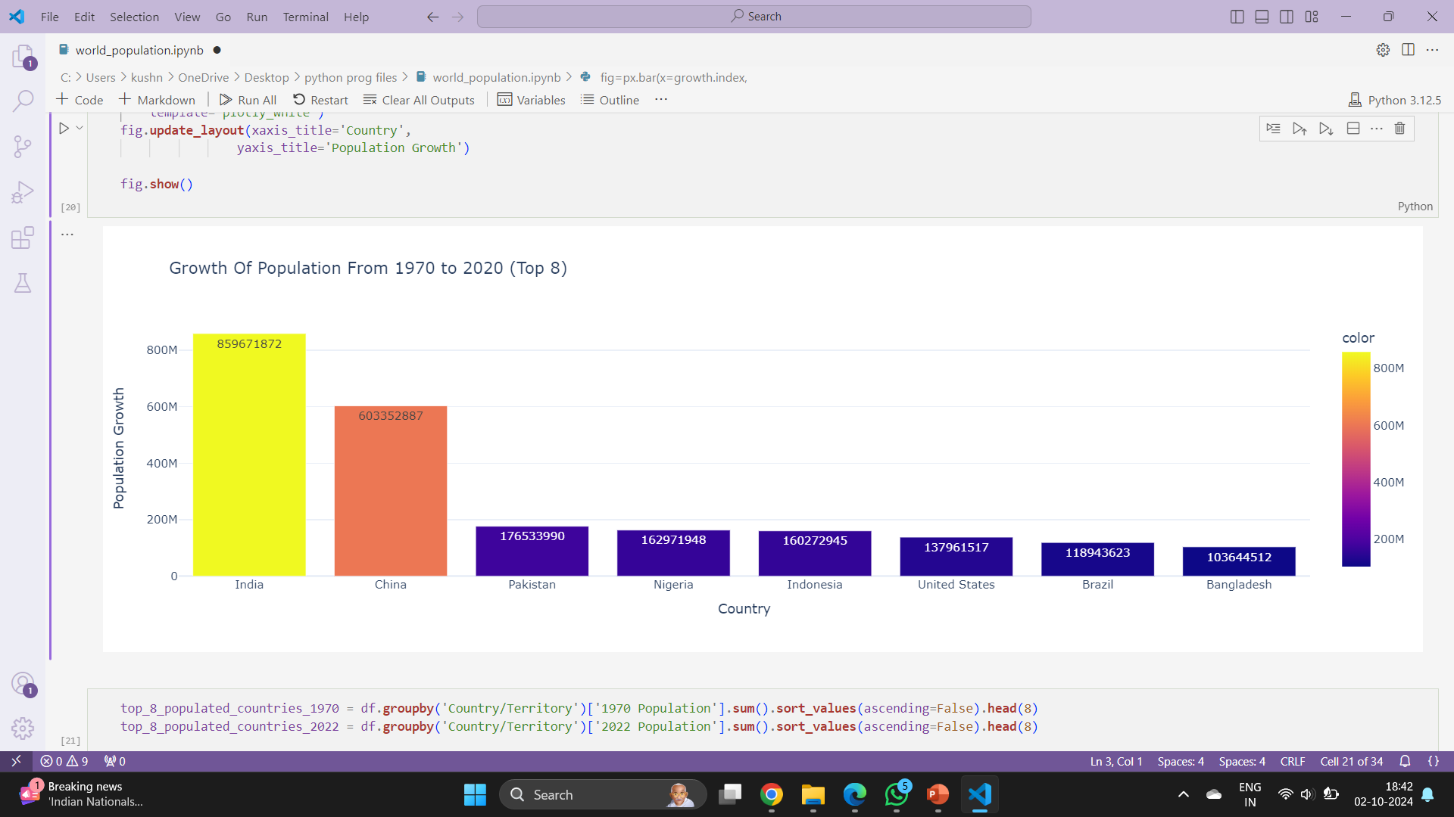

Slide 23
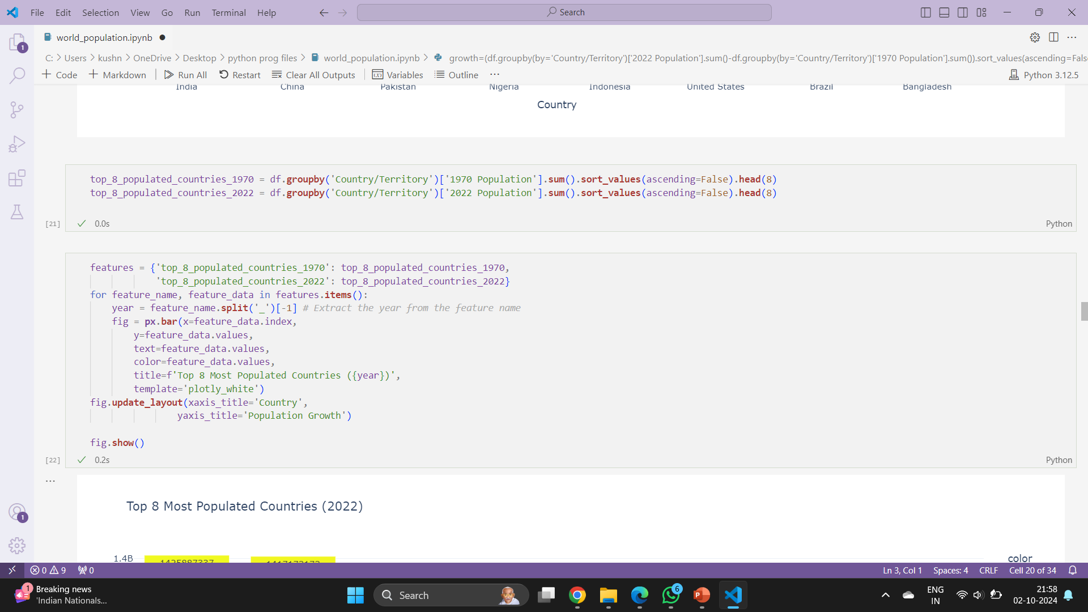
Top 8 Most Populated Countries (2022)

Slide 24
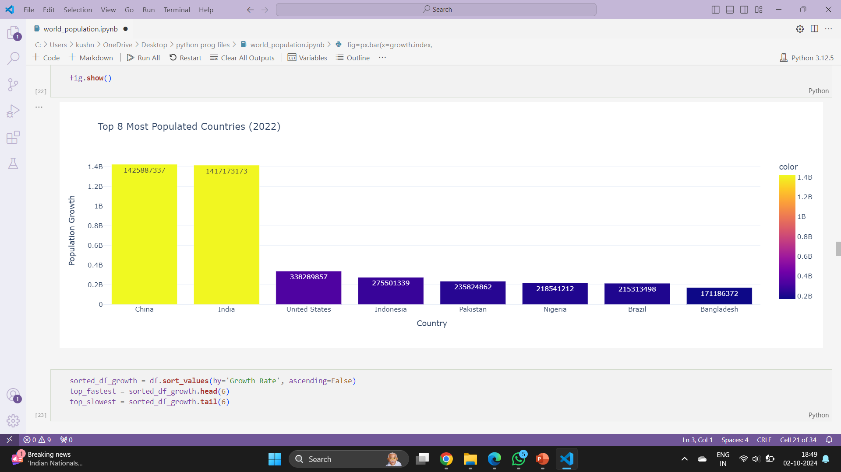

Slide 25
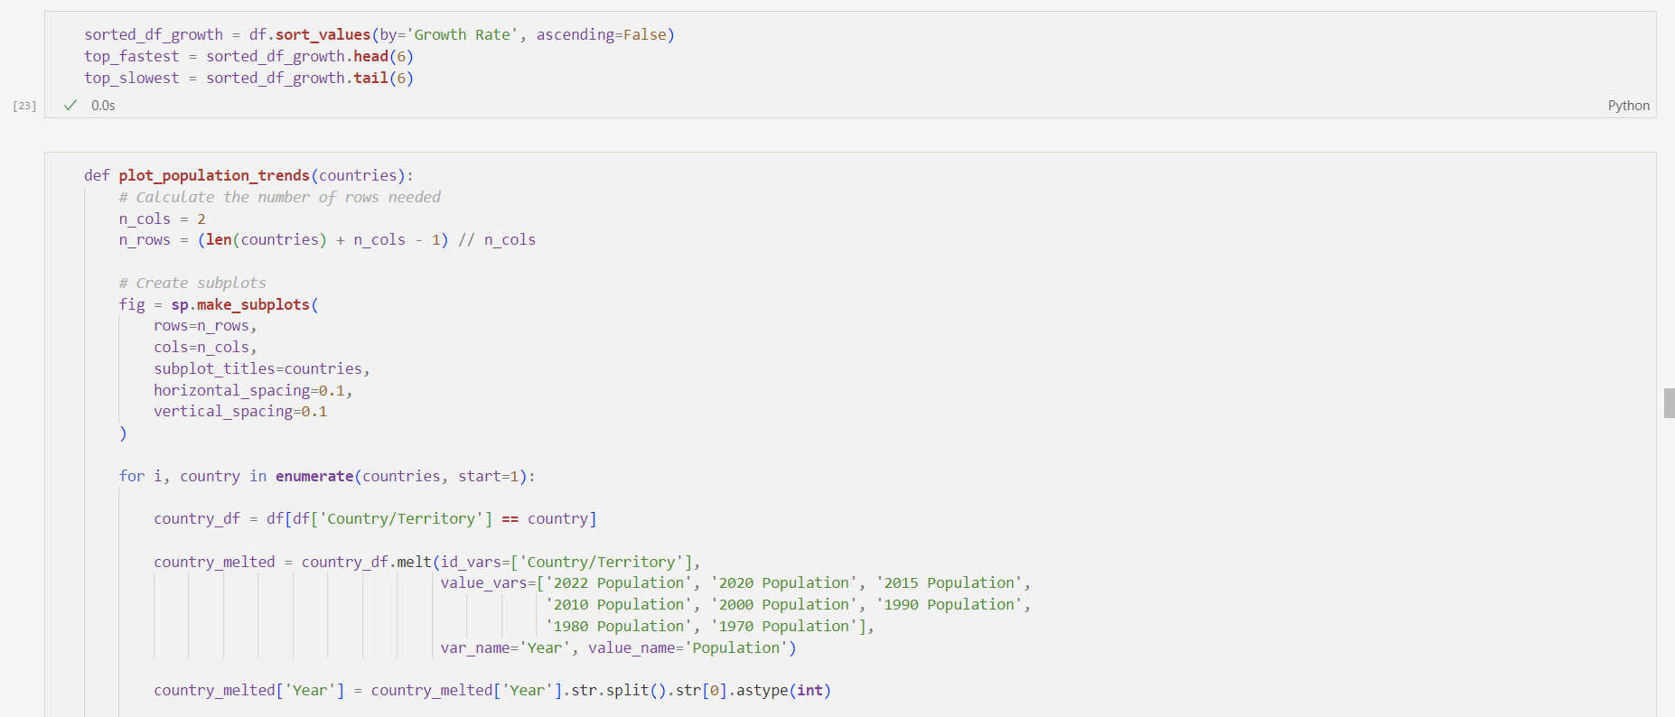
World Population Growth Rates: The Fastest Growing Countries

Slide 26
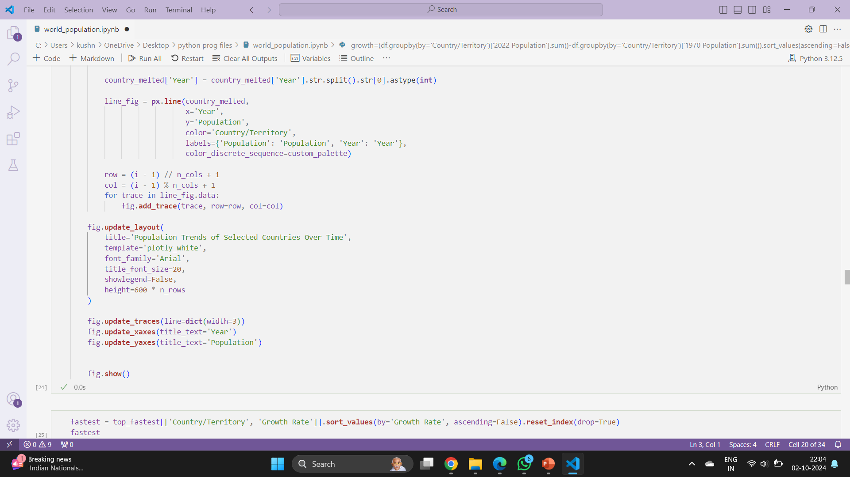

Slide 27
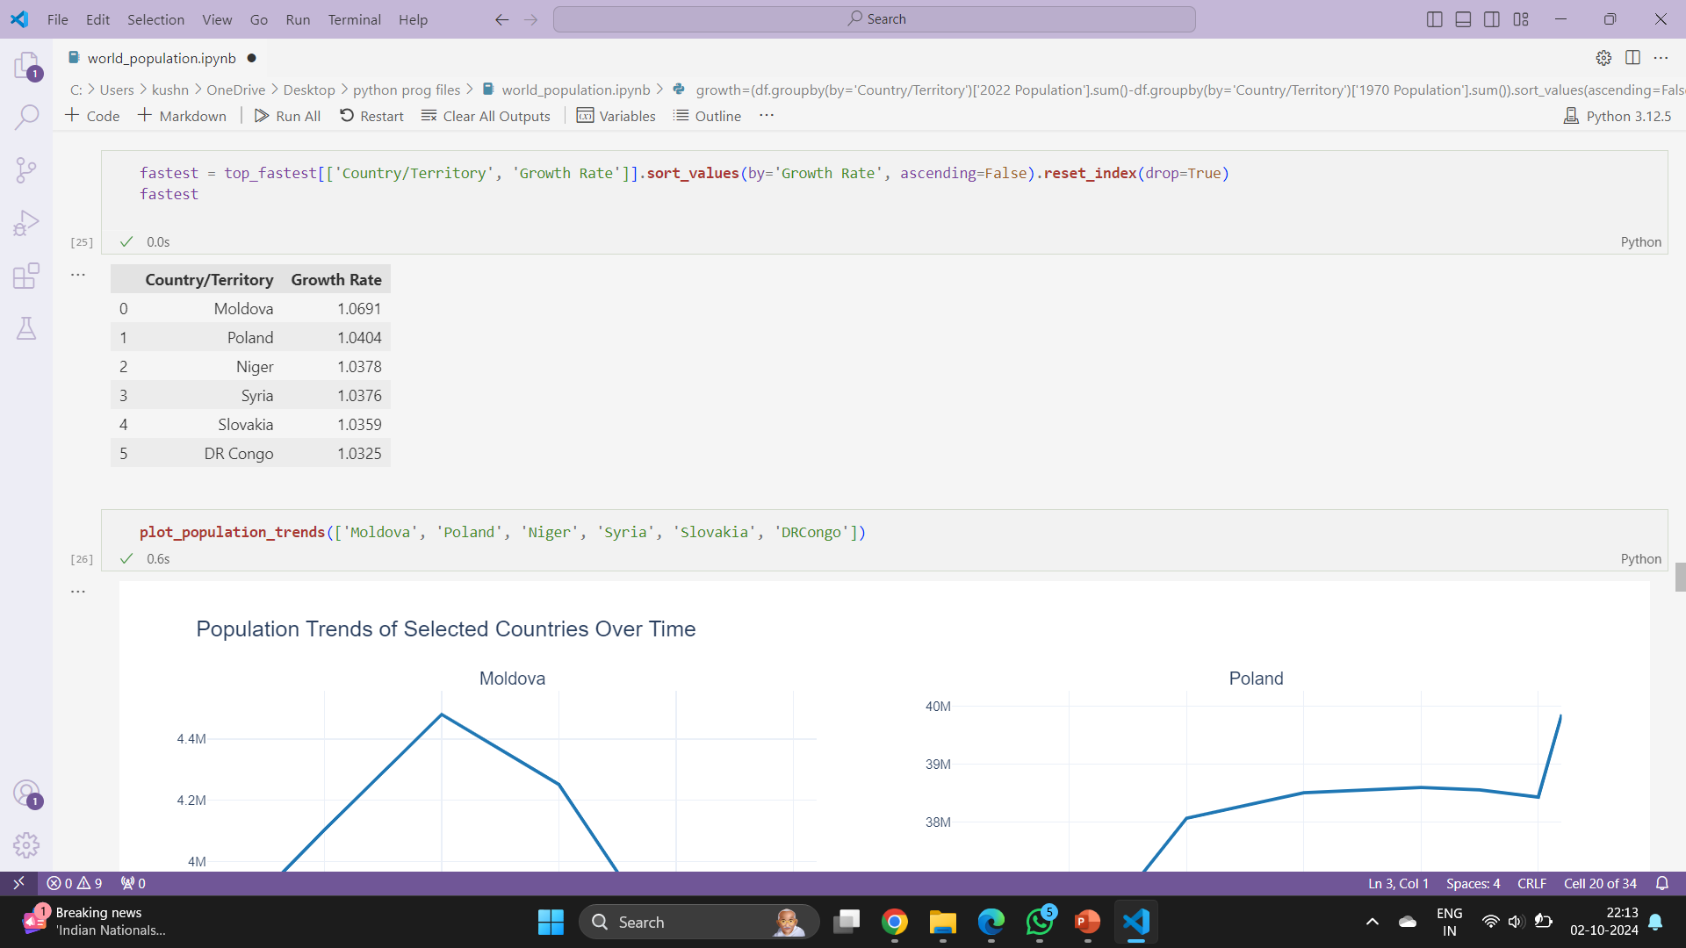

Slide 28
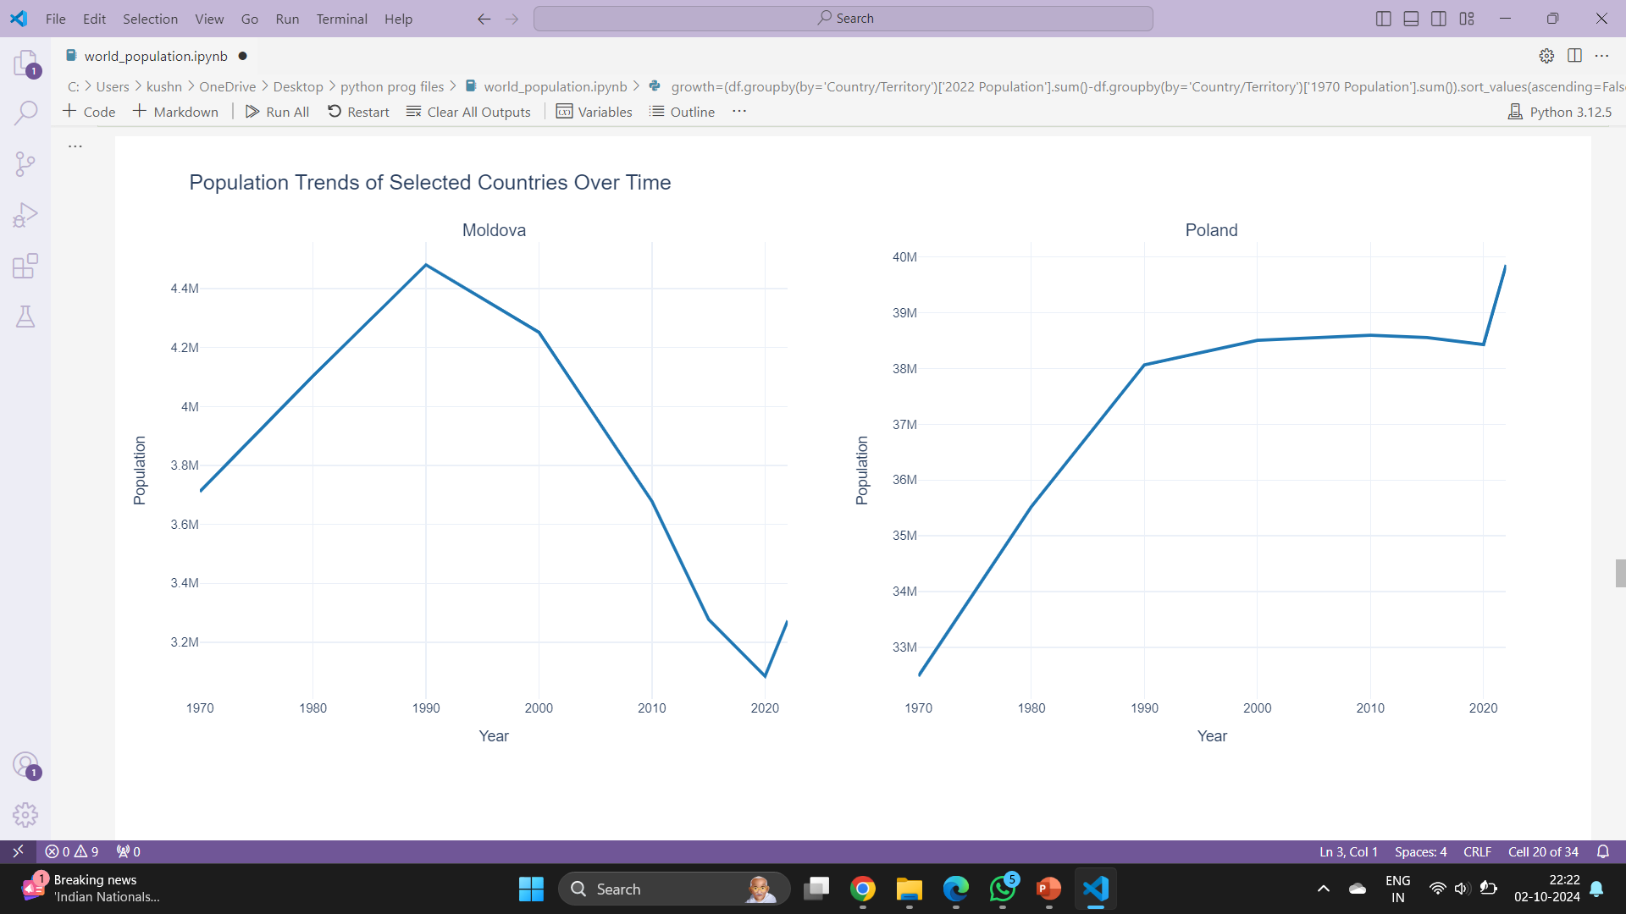
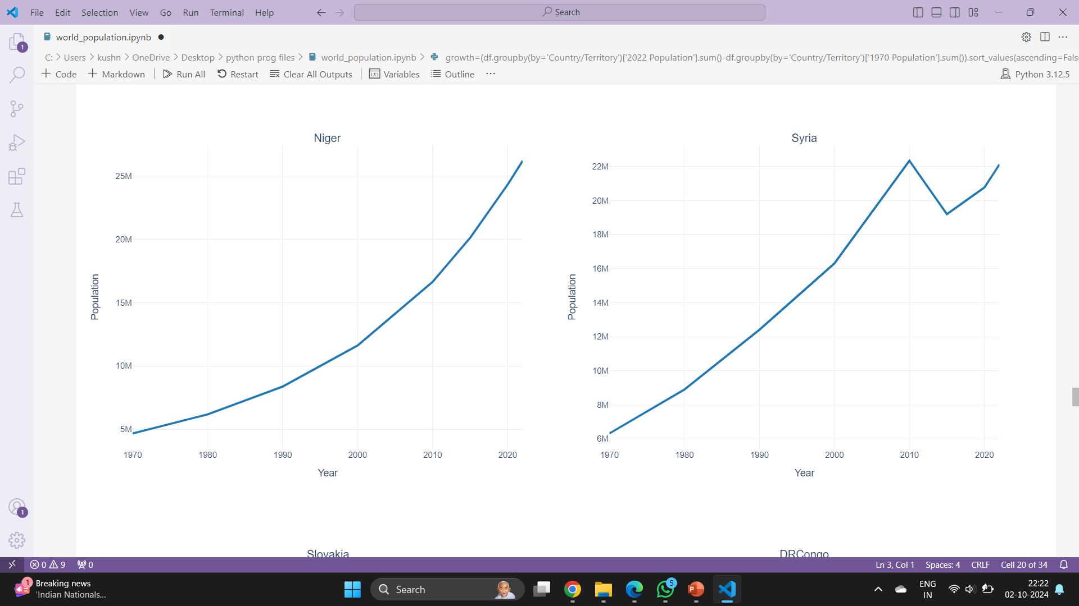
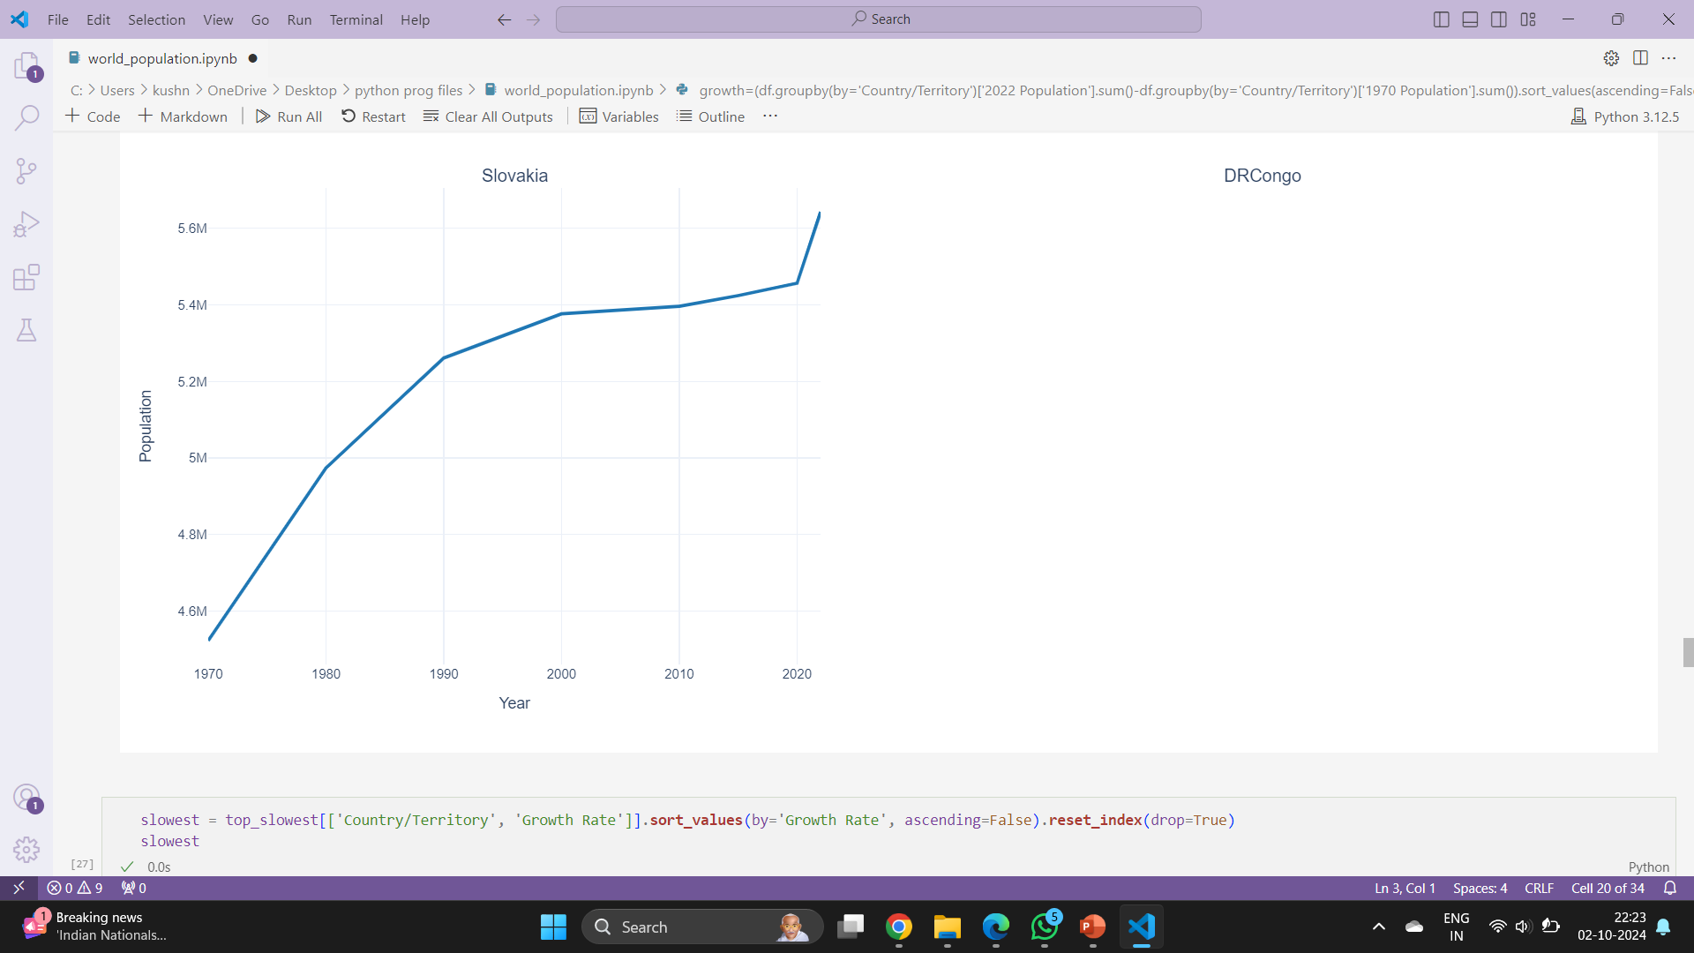

Slide 29
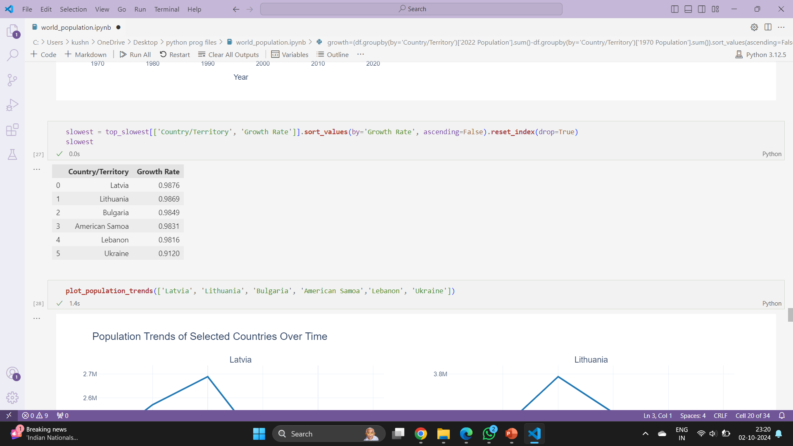
World Population Growth Rates: The Slowest Growing Countries

Slide 30
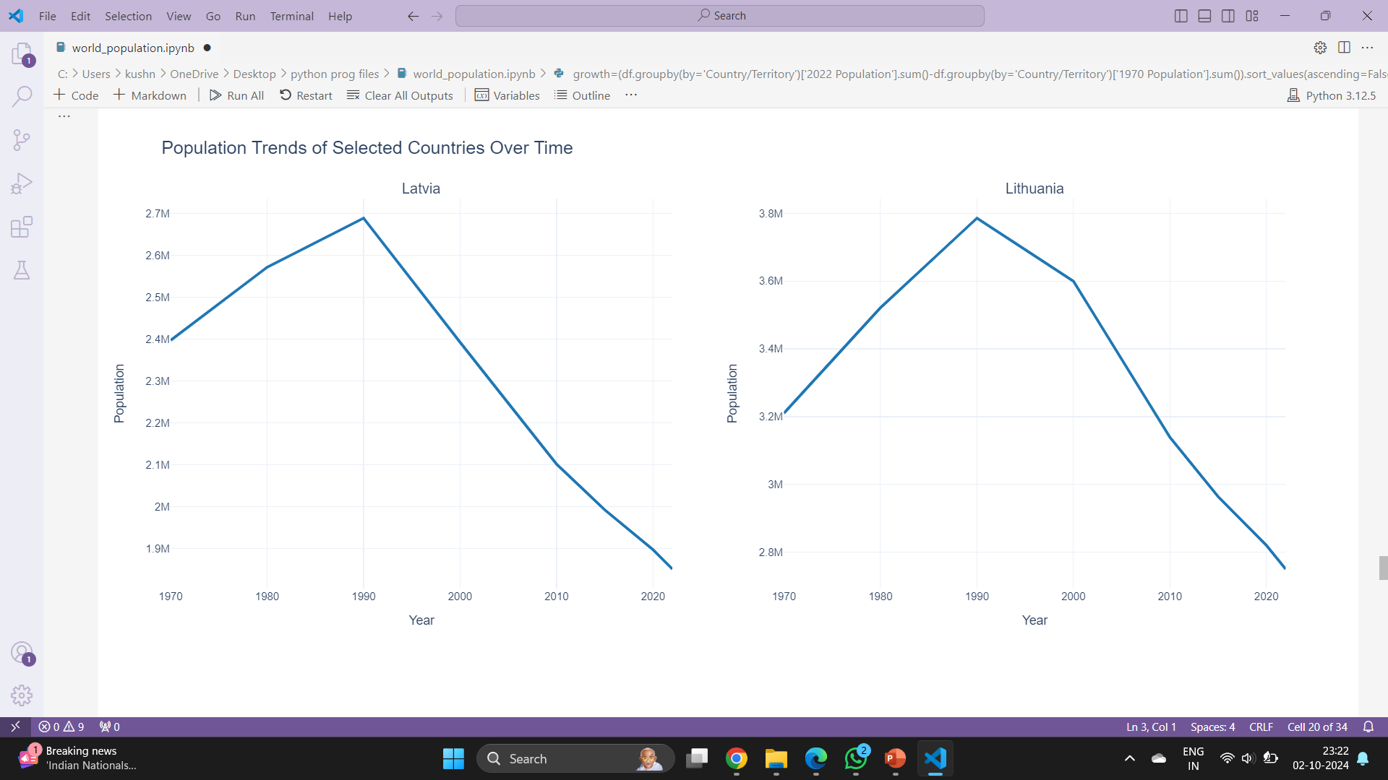
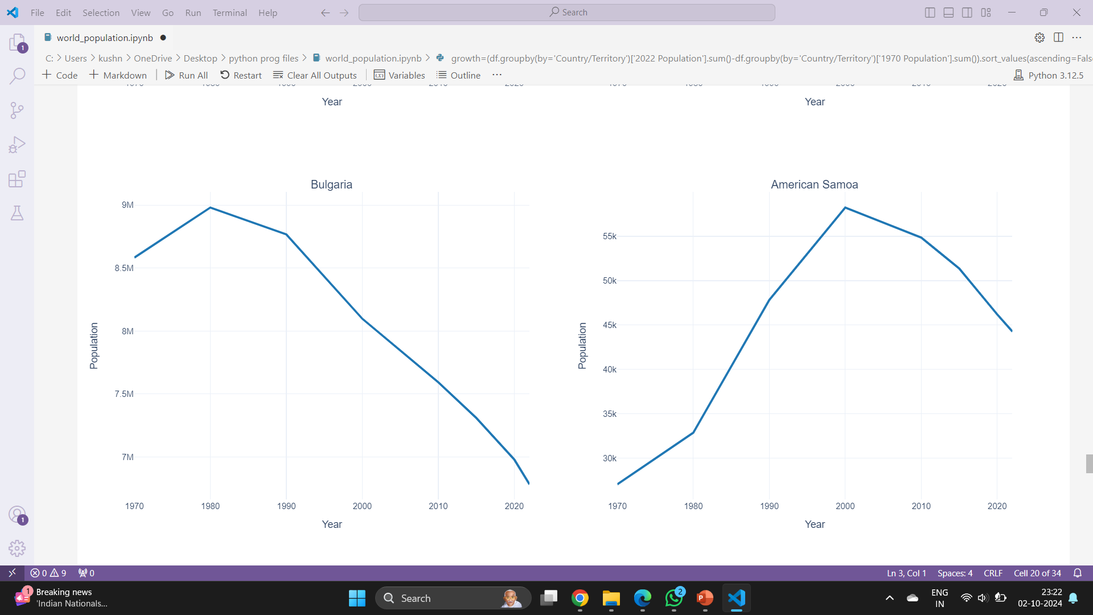
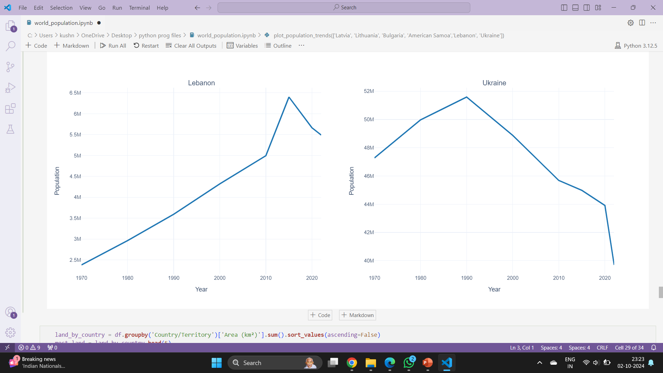

Slide 31
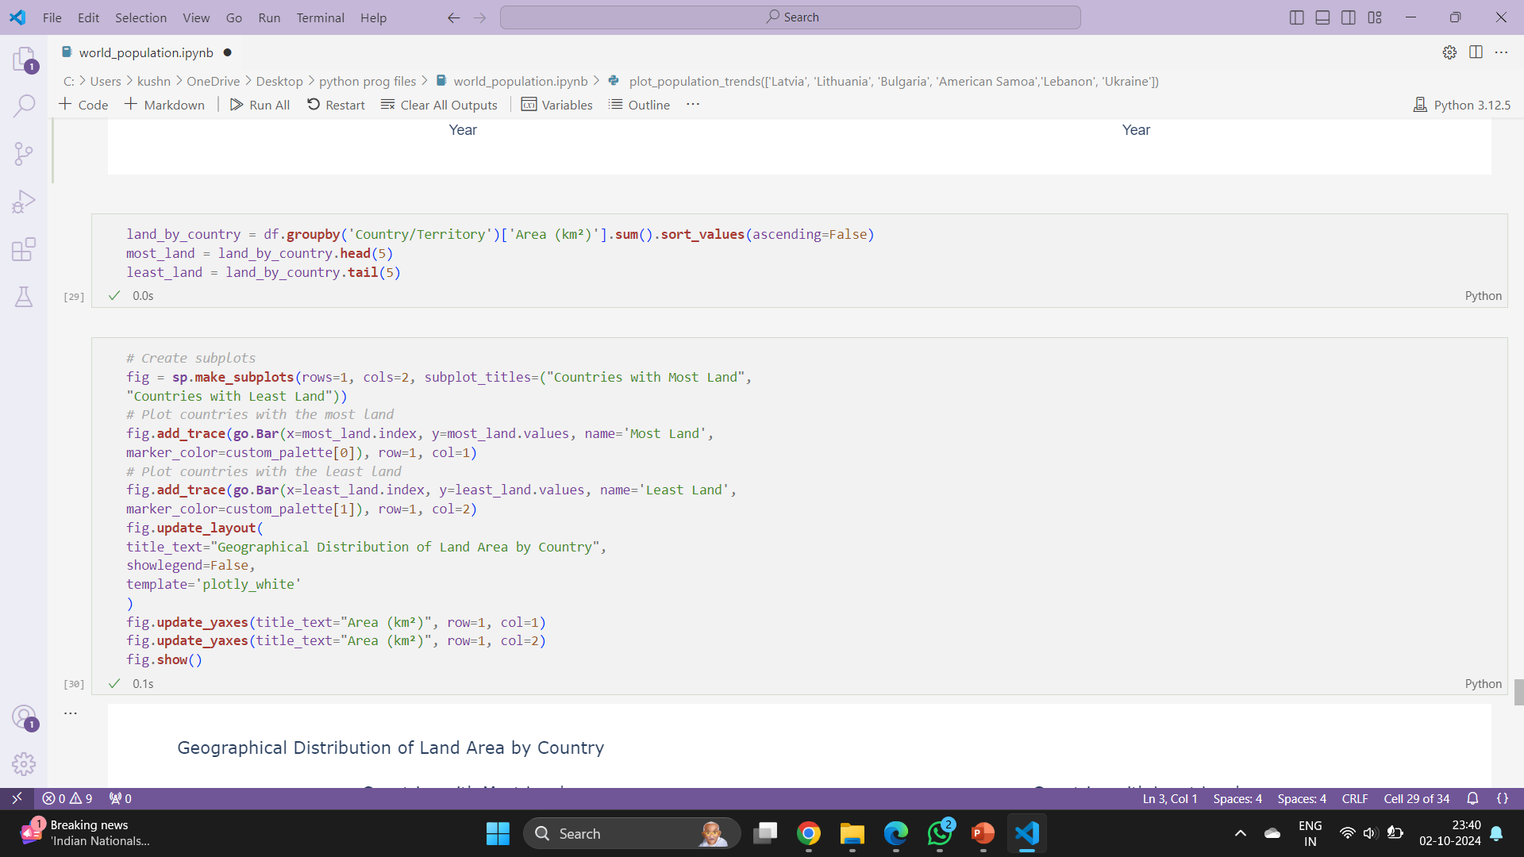
Land Area by Country

Slide 32
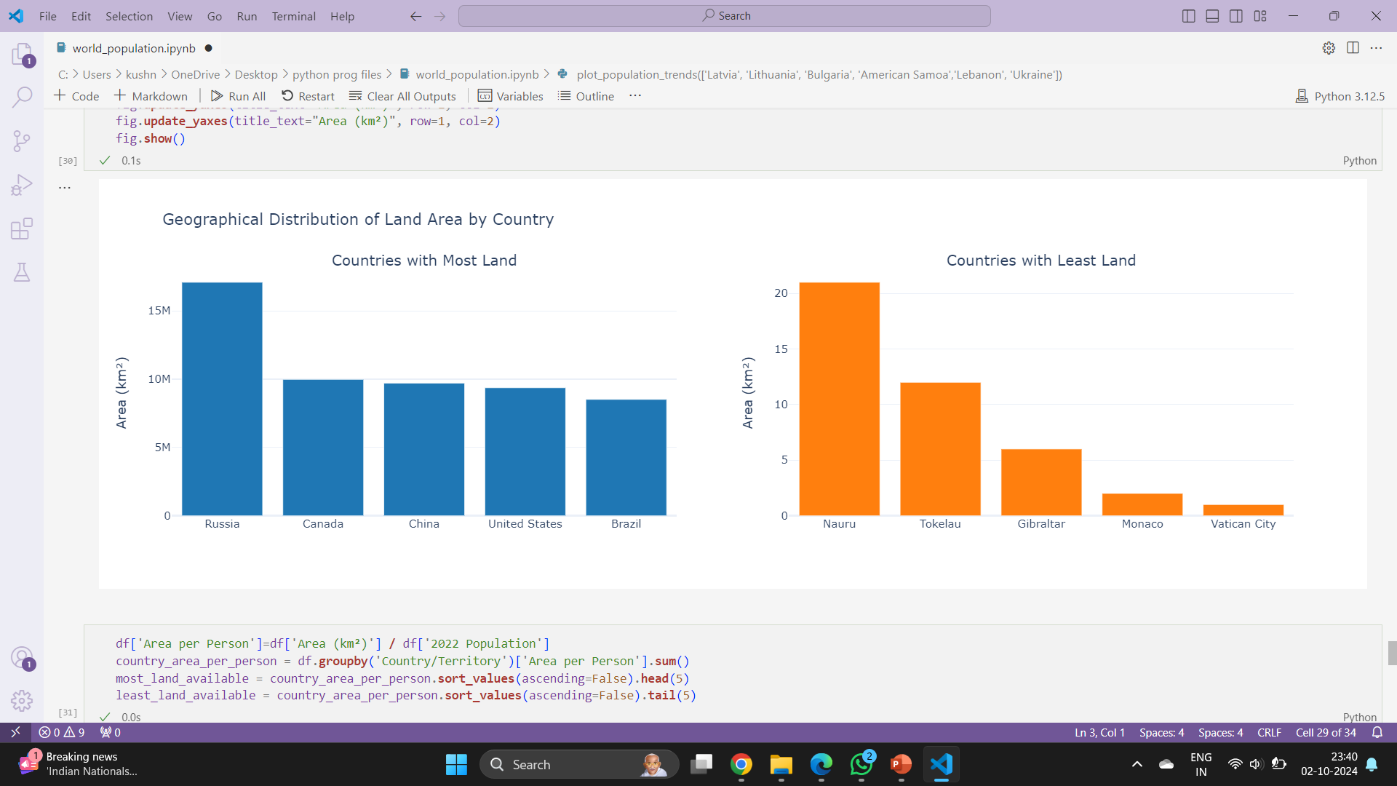

Slide 33
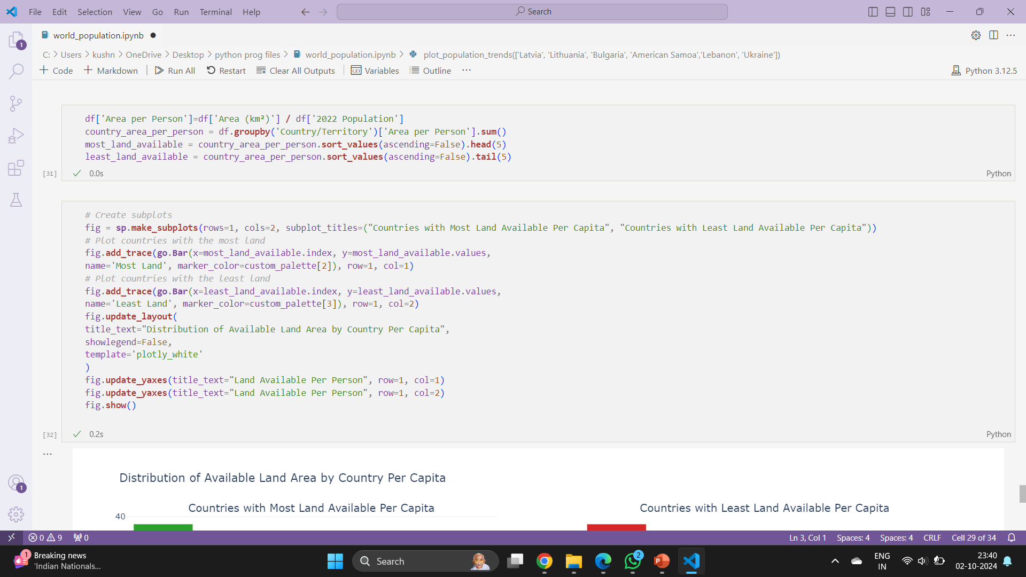
Land Area Per Person by Country

Slide 34
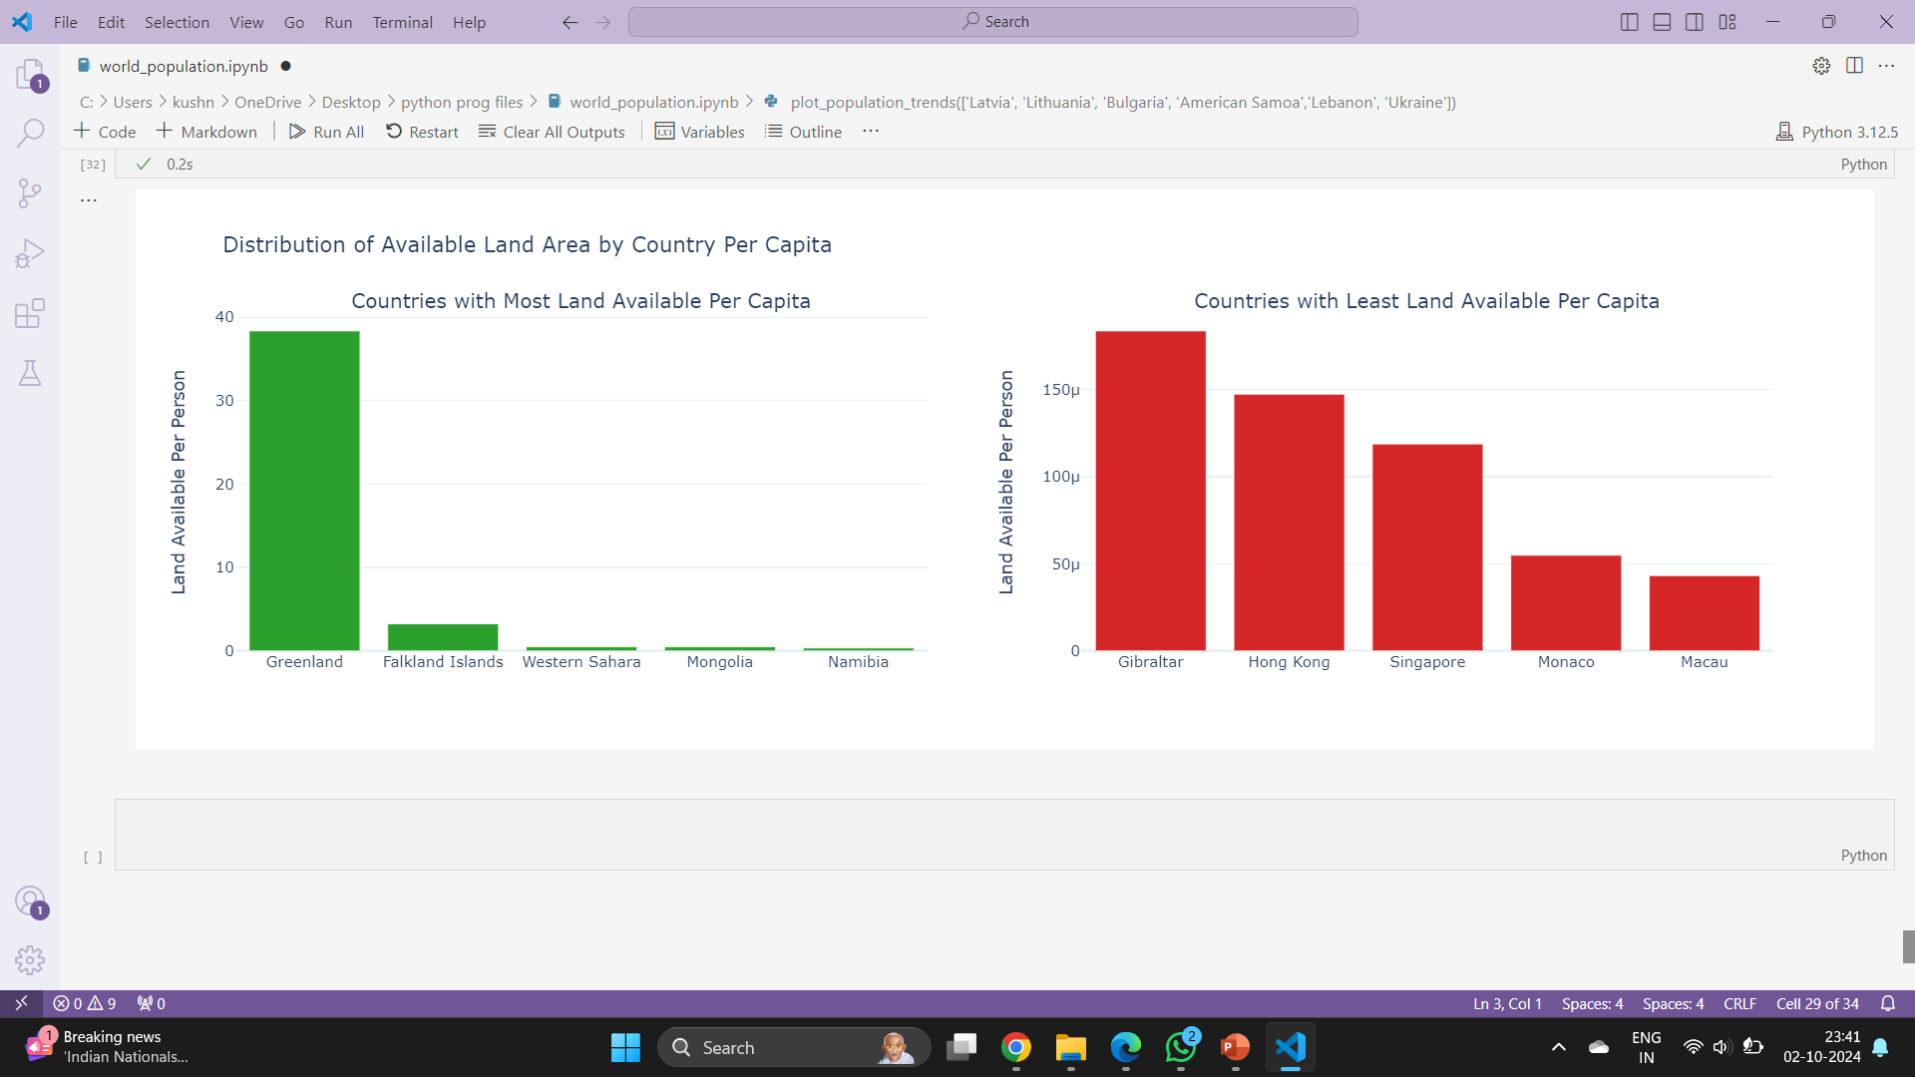

Slide 35
Results and Discussion
Interpretation of results: The results show how well the linear regression model predicts population growth based on the selected features. The R² score indicates the proportion of variance in population explained by the model.
Key insights from the analysis: Factors like birth rate and fertility rate likely play a significant role in population growth. The model provides a reasonable forecast of future population trends.
Limitations and potential improvements: The linear regression model might not fully capture the complexity of population dynamics, and additional features or a more sophisticated model could improve accuracy.

Slide 36
Conclusion
Summary of findings: The model predicts population trends with reasonable accuracy, but improvements can be made to enhance the predictive power. Population growth is largely influenced by factors like birth rate, death rate, and fertility rate.
Future work and recommendations: Future work could include more advanced models like decision trees or time series models, as well as additional demographic or economic features to improve predictions.

Slide 37



THANK YOU

